Slide 1
UPPER SIXTH ARTS
GEOGRAPHY
Map Analysis 2: Remote Sensing, Aerial Photographs and GIS
Remote Sensing, Aerial Photographs and GIS
Notes:
Good morning, class, and welcome to our geography lesson. I am your geography teacher, Mr Kamdem. Today we are starting Map Analysis 2: Remote Sensing, Aerial Photographs and GIS.

Slide 2
CLASS INFO
Class, Chapter and Duration
Class | Upper Sixth Arts
Chapter | Module 8: Understanding and carrying out statistical techniques, topographic map analysis, fieldwork and project based learning
Duration | 2 periods (2 × 50 minutes)
Notes:
This lesson is for Upper Sixth Arts. It belongs to Module 8: Understanding and carrying out statistical techniques, topographic map analysis, fieldwork and project based learning. We shall need 2 periods to cover it.

Slide 3
IDENTIFICATION
Lesson Identification
Topic | Topographic Map Analysis
Sub-topic | Initiation to modern cartographic techniques
Lesson | Map Analysis 2: Remote Sensing, Aerial Photographs and GIS
Notions / Concepts | Remote sensing, satellite image, aerial photograph, vertical, oblique, GIS, layer.
Syllabus focus | Meaning of remote sensing; basic techniques of remote sensing; aerial photograph interpretation; GIS mapping.
Competence | Learners are able to explain remote sensing and GIS and interpret simple aerial photographs.
Notes:
Our topic is Topographic Map Analysis, and the sub-topic is Initiation to modern cartographic techniques. The key notions we shall use today are: remote sensing, satellite image, aerial photograph, vertical, oblique, GIS, layer. At the end, you should be able to do this: learners are able to explain remote sensing and GIS and interpret simple aerial photographs.

Slide 4

HOMEWORK CORRECTION
Correction of the Homework
Question (Map Analysis 1: Review of Map Reading Principles):
Draw a map of your school with a key, a scale and a north arrow.
Notes:
Before we start the new lesson, let us correct the homework I gave you at the end of Map Analysis 1: Review of Map Reading Principles. The question was: Draw a map of your school with a key, a scale and a north arrow. Take out your exercise books.

Slide 5
HOMEWORK CORRECTION
Correction: Possible Answer
A good map has a frame, a title ("Map of GBHS Garoua"), a key for buildings, paths and trees, a linear scale (e.g. 1 cm = 10 m) and a north arrow.
Notes:
Here is a good answer. A good map has a frame, a title ("Map of GBHS Garoua"), a key for buildings, paths and trees, a linear scale (e.g. 1 cm = 10 m) and a north arrow. Compare it with your own answer and correct your work in red.

Slide 6
LESSON PLAN
Lesson Plan
Correction of the homework
Objectives and recall
Real-life situation and action to take
Learning activities
Board summary
Evaluation, remediation and homework
Notes:
Here is the plan of our lesson today. First, we shall correct the homework. Then we shall look at the objectives and recall what you already know. After that, we shall study a situation from real life and the action to take, and do the learning activities. Finally, we shall copy the board summary, do the evaluation and the remediation, and I will give you the homework.

Slide 7
OBJECTIVES
Objectives
By the end of this lesson, you should be able to:
Define remote sensing and describe how it works.
Distinguish vertical and oblique aerial photographs and interpret them.
Notes:
Take your time to copy this part; we will continue together.

Slide 8
OBJECTIVES
Objectives (continued)
Explain GIS and its uses.
Notes:
By the end of this lesson, you should be able to do three things. Number 1: define remote sensing and describe how it works. Number 2: distinguish vertical and oblique aerial photographs and interpret them. Number 3: explain GIS and its uses.

Slide 9
PREVIOUS KNOWLEDGE
Previous Knowledge
Satellites orbit the Earth.
Google Maps shows images of places.
Notes:
Let us first remember what you already know. Satellites orbit the Earth. Google Maps shows images of places. Keep this in mind, because we shall build on it today.

Slide 10
REAL-LIFE SITUATION
Situation in Real Life
A student opens a satellite image of Douala on a phone. She can see the Wouri river, the port and new buildings that are not on the old paper map of the school.
Notes:
Listen carefully to this situation from real life. A student opens a satellite image of Douala on a phone. She can see the Wouri river, the port and new buildings that are not on the old paper map of the school. Think about it, because I am going to ask you some questions.

Slide 11
REAL-LIFE SITUATION
Situation: Question 1
What is the problem in the situation?
Notes:
Question 1: What is the problem in the situation? Think for a moment, then raise your hand to answer.

Slide 12
REAL-LIFE SITUATION
Answer
Old maps are out of date; images show new changes.
Notes:
Good. Old maps are out of date; images show new changes.

Slide 13
REAL-LIFE SITUATION
Situation: Question 2
How was the image obtained?
Notes:
Question 2: How was the image obtained? Think for a moment, then raise your hand to answer.

Slide 14
REAL-LIFE SITUATION
Answer
By a satellite (remote sensing).
Notes:
Good. By a satellite (remote sensing).

Slide 15
REAL-LIFE SITUATION
Situation: Question 3
What system can combine the image with maps?
Notes:
Question 3: What system can combine the image with maps? Think for a moment, then raise your hand to answer.

Slide 16
REAL-LIFE SITUATION
Possible Answer
A GIS.
Notes:
Good. A GIS.

Slide 17
ACTION TO TAKE
Action to Take
Use maps, images and GIS tools to plan and protect our environment.
Notes:
From this situation, the action we are working towards in this lesson is the following: use maps, images and GIS tools to plan and protect our environment.

Slide 18
JUSTIFICATION
Justification of the Lesson
This lesson introduces modern tools that geographers use to study places.
Notes:
Why is this lesson important for you? This lesson introduces modern tools that geographers use to study places.

Slide 19
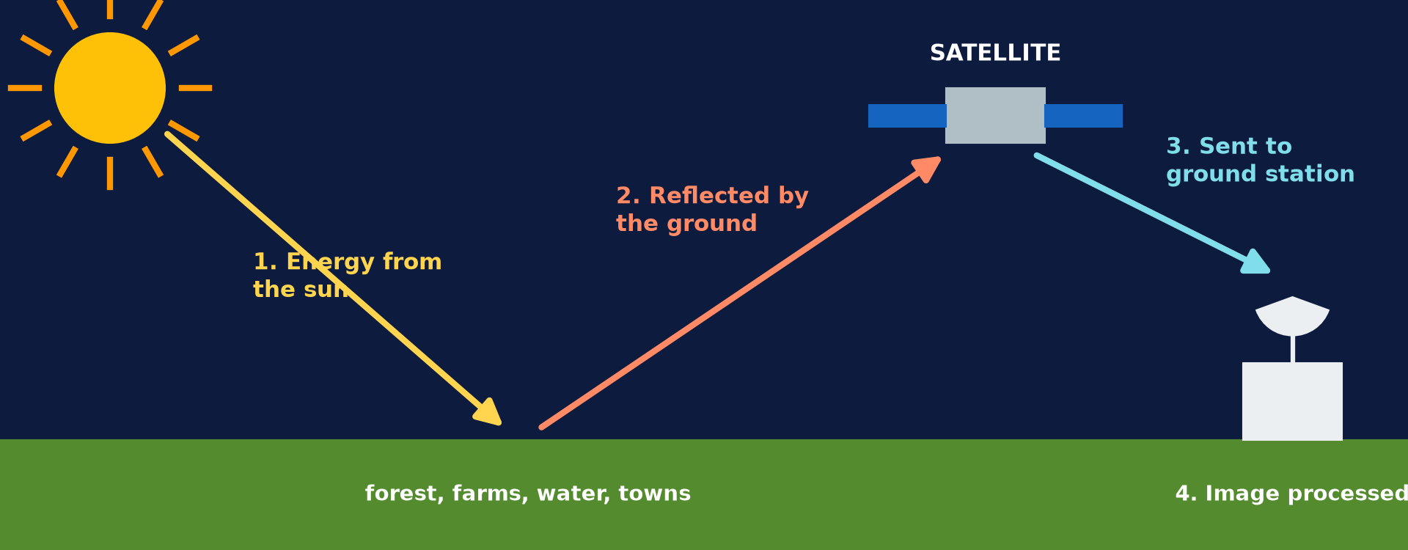
1. MEANING OF REMOTE SENSING
Activity 1
How remote sensing works.
Notes:
Activity 1. Look carefully at this diagram: how remote sensing works. Observe every detail before I ask the question.

Slide 20
1. MEANING OF REMOTE SENSING
Activity 1: Question
What is remote sensing?
Notes:
Here is the question for Activity 1: What is remote sensing? Take one minute to think and write your answer in your rough notebook.

Slide 21
1. MEANING OF REMOTE SENSING
Activity 1: Answer
Getting information about the Earth from a distance, with satellites or aircraft.
Notes:
Let us check the answer together. Getting information about the Earth from a distance, with satellites or aircraft.

Slide 22
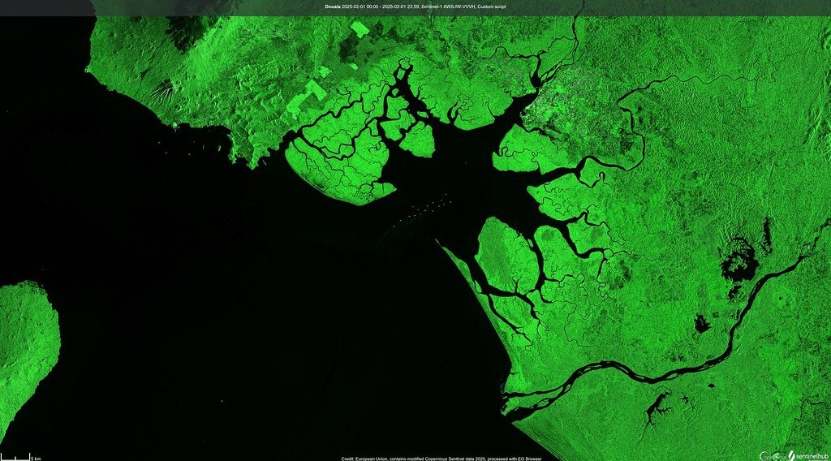
1. SATELLITE IMAGES
Activity 2
A satellite image of the Wouri estuary.
Notes:
Activity 2. Look carefully at this picture: a satellite image of the Wouri estuary. Observe every detail before I ask the question.

Slide 23
1. SATELLITE IMAGES
Activity 2: Question
Name two features you can identify on the image.
Notes:
Here is the question for Activity 2: Name two features you can identify on the image. Take one minute to think and write your answer in your rough notebook.

Slide 24
1. SATELLITE IMAGES
Activity 2: Answer
The river estuary and the town (also mangroves).
Notes:
Let us check the answer together. The river estuary and the town (also mangroves).

Slide 25
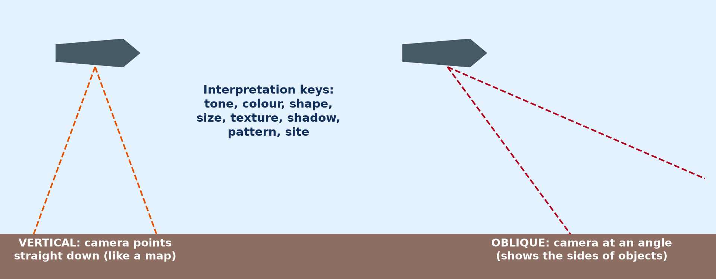
2. AERIAL PHOTOGRAPHS
Activity 3
Vertical and oblique photographs.
Notes:
Activity 3. Look carefully at this diagram: vertical and oblique photographs. Observe every detail before I ask the question.

Slide 26
2. AERIAL PHOTOGRAPHS
Activity 3: Question
Distinguish vertical and oblique aerial photographs.
Notes:
Here is the question for Activity 3: Distinguish vertical and oblique aerial photographs. Take one minute to think and write your answer in your rough notebook.

Slide 27
2. AERIAL PHOTOGRAPHS
Activity 3: Answer
Vertical: taken straight down like a map. Oblique: taken at an angle, showing sides.
Notes:
Let us check the answer together. Vertical: taken straight down like a map. Oblique: taken at an angle, showing sides.

Slide 28
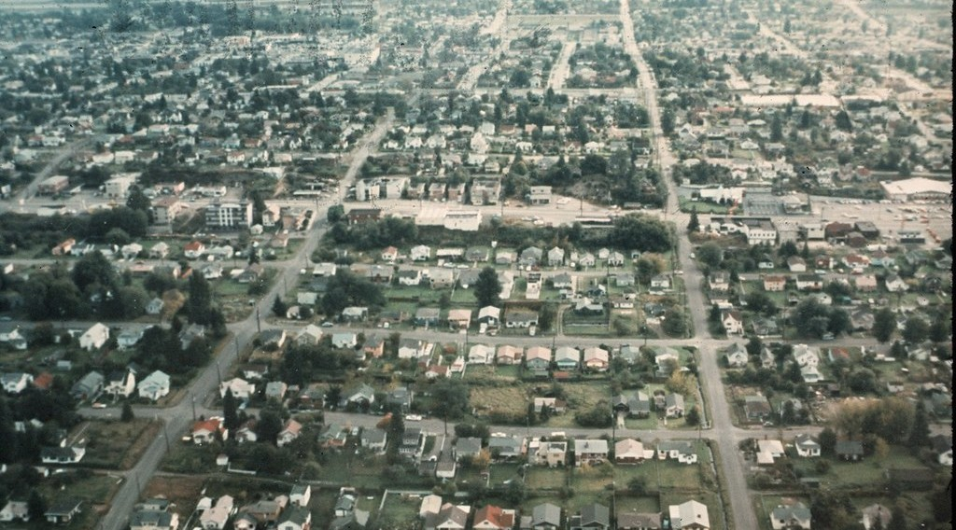
2. INTERPRETATION
Activity 4
An aerial photograph.
Notes:
Activity 4. Look carefully at this picture: an aerial photograph. Observe every detail before I ask the question.

Slide 29
2. INTERPRETATION
Activity 4: Question
Name three keys used to interpret aerial photographs.
Notes:
Here is the question for Activity 4: Name three keys used to interpret aerial photographs. Take one minute to think and write your answer in your rough notebook.

Slide 30
2. INTERPRETATION
Activity 4: Answer
Tone, shape and size (also texture, shadow, pattern).
Notes:
Let us check the answer together. Tone, shape and size (also texture, shadow, pattern).

Slide 31
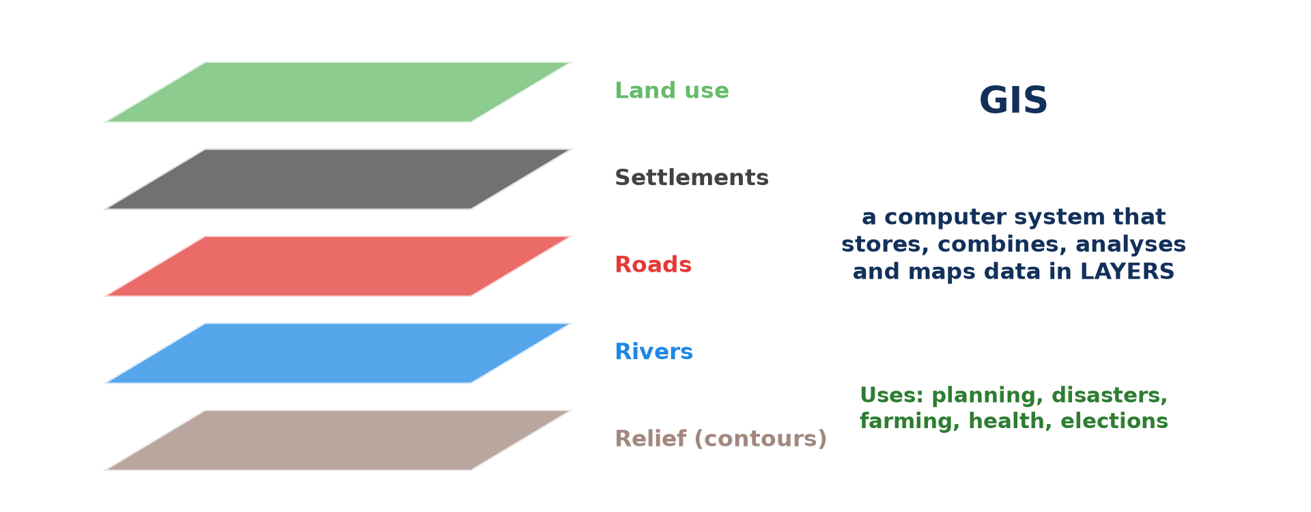
3. GIS MAPPING
Activity 5
GIS layers.
Notes:
Activity 5. Look carefully at this diagram: gIS layers. Observe every detail before I ask the question.

Slide 32
3. GIS MAPPING
Activity 5: Question
Give two uses of GIS.
Notes:
Here is the question for Activity 5: Give two uses of GIS. Take one minute to think and write your answer in your rough notebook.

Slide 33
3. GIS MAPPING
Activity 5: Answer
Town planning and disaster management (also farming, health).
Notes:
Let us check the answer together. Town planning and disaster management (also farming, health).

Slide 34
BOARD SUMMARY
Board Summary
Topic: Topographic Map Analysis
Sub-topic: Initiation to modern cartographic techniques
Map Analysis 2: Remote Sensing, Aerial Photographs and GIS
Notes:
Now we are going to copy the board summary. Write the title and the headings neatly in your notebooks. I will give you enough time for each slide, so do not rush.

Slide 35
BOARD SUMMARY
1. Remote Sensing
Remote sensing can be explained as follows:
Meaning: Remote sensing is getting information about the Earth from a distance, using satellites or aircraft. Sensors record the energy reflected or emitted by the surface.
Notes:
Let us copy Remote Sensing. Remote sensing can be explained as follows. On this slide we have Meaning. Write each point on a new line, with the key term first, and explain it in your own words when we revise. When you finish, we go to the next slide.

Slide 36
BOARD SUMMARY
1. Remote Sensing (continued)
Basic techniques: Passive sensors record reflected sunlight, while active sensors such as radar send their own signal. Images are processed by computer and shown in true or false colour.
Notes:
We continue with Remote Sensing. On this slide we have Basic techniques. Write each point on a new line, with the key term first, and explain it in your own words when we revise.

Slide 37
BOARD SUMMARY
1. Remote Sensing
Illustration: how remote sensing works
Notes:
Now draw this illustration in your notebook: how remote sensing works. Give it a title and label it clearly.

Slide 38
BOARD SUMMARY
2. Aerial Photographs and their Interpretation
Aerial photographs are classified and read as follows:
Vertical photographs: They are taken straight down and look like a map. They are used to make and update maps.
Notes:
Let us copy Aerial Photographs and their Interpretation. Aerial photographs are classified and read as follows. On this slide we have Vertical photographs. Write each point on a new line, with the key term first, and explain it in your own words when we revise. When you finish, we go to the next slide.

Slide 39
BOARD SUMMARY
2. Aerial Photographs and their Interpretation (continued)
Oblique photographs: They are taken at an angle and show the sides of features. Low obliques do not show the horizon, while high obliques do.
Notes:
We continue with Aerial Photographs and their Interpretation. On this slide we have Oblique photographs. Write each point on a new line, with the key term first, and explain it in your own words when we revise. When you finish, we go to the next slide.

Slide 40
BOARD SUMMARY
2. Aerial Photographs and their Interpretation (continued)
Interpretation keys: Features are recognised by their tone, shape, size, texture, shadow and pattern. Their position with other features also helps.
Notes:
We continue with Aerial Photographs and their Interpretation. On this slide we have Interpretation keys. Write each point on a new line, with the key term first, and explain it in your own words when we revise.

Slide 41
BOARD SUMMARY
2. Aerial Photographs and their Interpretation
Illustration: vertical and oblique photographs
Notes:
Now draw this illustration in your notebook: vertical and oblique photographs. Give it a title and label it clearly.

Slide 42
BOARD SUMMARY
3. GIS Mapping
GIS can be explained as follows:
Meaning: A Geographical Information System is a computer system that stores, analyses and displays data linked to places. Each type of data is kept as a layer.
Notes:
Let us copy GIS Mapping. GIS can be explained as follows. On this slide we have Meaning. Write each point on a new line, with the key term first, and explain it in your own words when we revise. When you finish, we go to the next slide.

Slide 43
BOARD SUMMARY
3. GIS Mapping (continued)
Uses: GIS is used in town planning, disaster management, farming and health. It combines layers to answer questions, such as where to build a school.
Notes:
We continue with GIS Mapping. On this slide we have Uses. Write each point on a new line, with the key term first, and explain it in your own words when we revise.

Slide 44
BOARD SUMMARY
3. GIS Mapping
Illustration: GIS layers
Notes:
Now draw this illustration in your notebook: gIS layers. Give it a title and label it clearly.

Slide 45
FORMATIVE EVALUATION
Evaluation 1
Give two advantages of satellite images over paper maps.
Notes:
Now let us check what you have understood. Question 1: Give two advantages of satellite images over paper maps. Answer in your exercise book.

Slide 46
FORMATIVE EVALUATION
Expected Answer
They are up to date and cover large areas.
Notes:
The expected answer is: they are up to date and cover large areas. If you got it right, well done.

Slide 47
FORMATIVE EVALUATION
Evaluation 2
Name three interpretation keys.
Notes:
Now let us check what you have understood. Question 2: Name three interpretation keys. Answer in your exercise book.

Slide 48
FORMATIVE EVALUATION
Expected Answer
Tone, shape and texture.
Notes:
The expected answer is: tone, shape and texture. If you got it right, well done.

Slide 49
REMEDIATION
Remediation
Fill in the blanks:
Collecting data from a distance is ______ sensing.
A photo taken at an angle is ______.
Data in GIS are stored in ______.
Notes:
For those who need more practice, fill in the blanks in your exercise book. The answers are: number 1, remote; number 2, oblique; number 3, layers.

Slide 50
HOMEWORK
Homework
Use a phone map app to find your school and describe the land use around it.
Notes:
For your homework: Use a phone map app to find your school and describe the land use around it. We shall correct it at the beginning of our next lesson.

Slide 51
NEXT LESSON
Next Lesson
Our next lesson will be on:
Map Analysis 3: Relief on Maps
Notes:
Our next lesson will be on Map Analysis 3: Relief on Maps. Thank you for your attention, and see you next time.

Slide 52
BILINGUAL GAME
Bilingual Game (Jeu Bilingue)
English | Français
Remote sensing | La télédétection
Satellite image | L'image satellite
Aerial photograph | La photographie aérienne
Layer | La couche
Sensor | Le capteur
Mapping | La cartographie
Notes:
Let us play the bilingual game. I say a word in English, and you give me the French word. Then we do the reverse.

Slide 53
LOGBOOK
Official Logbook (1/2)
Module / Topic | Topographic Map Analysis
Lesson Title | Map Analysis 2: Remote Sensing, Aerial Photographs and GIS
Expected Learning Outcomes | Define remote sensing and describe how it works. Distinguish vertical and oblique aerial photographs and interpret them. Explain GIS and its uses.
Competence | Learners are able to explain remote sensing and GIS and interpret simple aerial photographs.
Notes:
I record this information in the official logbook of the class after the lesson.

Slide 54
LOGBOOK
Official Logbook (2/2)
Matter Taught | Remote Sensing; Aerial Photographs and their Interpretation; GIS Mapping.
Evaluation | Formative evaluation and remediation exercise.
Homework | Use a phone map app to find your school and describe the land use around it.
Enrolment / Present / Absent | ____ / ____ / ____
Achievement | To be completed after the lesson.
Notes:
I complete the second page of the logbook: the matter taught, the evaluation, the homework and the attendance.

Slide 55
TEACHER'S NOTE
Teacher's Note
Timing: Homework correction, plan, objectives 8 min | Recall, situation, action 10 min | 5 activities 30 min | Board summary (copying) 30 min | Evaluation, remediation 10 min | Homework, next lesson 5 min | Logbook 7 min
Without the projector (Activity 1): describe the steps.
Without the projector (Activity 2): describe what you see.
Without the projector (Activity 3): compare the two.
Without the projector (Activity 4): interpret a photo.
Without the projector (Activity 5): discuss uses.
Notes:
This slide is for me, the teacher: it gives the timing of the lesson and what to do if the projector is not available.

Slide 56
REFERENCES
References
National Geography Syllabus, MINESEC/IGE/IP-SS, 2019 — Module 8 (Practical Geography).
Photo, Activity 2: “Duala, Camerún (Douala, Cameroon)” by migmasat, Public domain 1.0, via Flickr (https://www.flickr.com/photos/197415759@N06/54386998088)
Photo, Activity 4: “Aerial of Greenwood, 1969” by Seattle Municipal Archives, CC BY 2.0, via Flickr (https://www.flickr.com/photos/24256351@N04/10161924795)
Diagrams and animations: drawn for this lesson (Geography Department).
Notes:
These are the references and picture credits used to prepare this lesson.

